Slide 1
Post Mortem fourth stage
Ulcerative lymphangitis
Dr. Budoor Muhammad
Department of Pathology and Poultry Disease
College of Veterinary Medicine university of Basrah

Slide 3
Ulcerative Lymphangitis is an infectious;
mildly contagious disease of horses and cattle
caused principally by Corynebacterium
pseudotuberculosis. It is a lymphangitis of the
lower limbs, marked by the presence of
nodules and ulcers which discharge green
pus. In sheep this agent induces Caseous
Lymphadenitis.

Slide 5
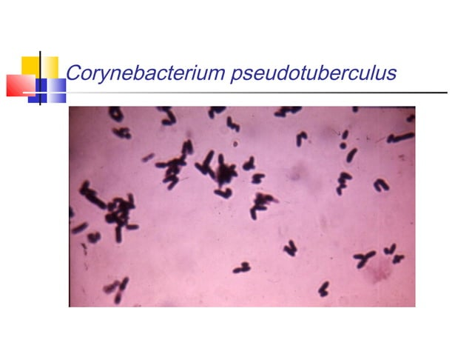
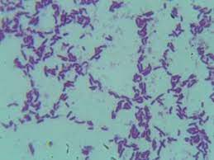

Slide 7
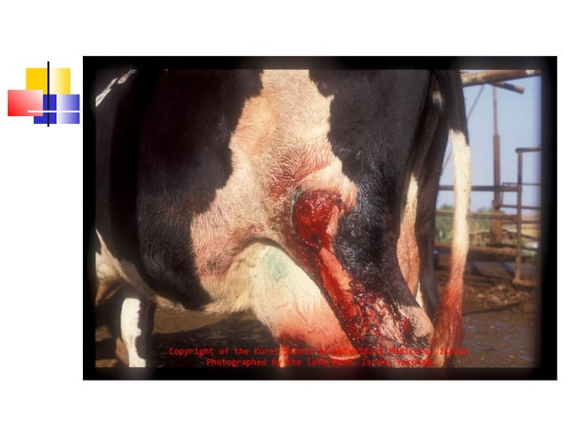

Slide 11
Pathogenesis
• After infection of skin wounds or abrasion--- C.
ovis multiply and secrete exotoxins----- invade
lymphatic vessels( usually of hind limbs starting at fetlock )with abscess formation papules or
nodules on the course of lymph vessels--------
• progress toward inguinal region---- abscess
rupture result in ulcer and crust and formation of
draining tracts, lymph nodes involvement is
unusual------ swelling and pain of legs with
lameness.

